Slide 1
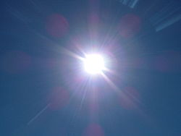
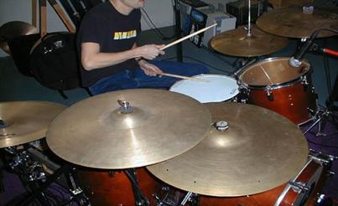
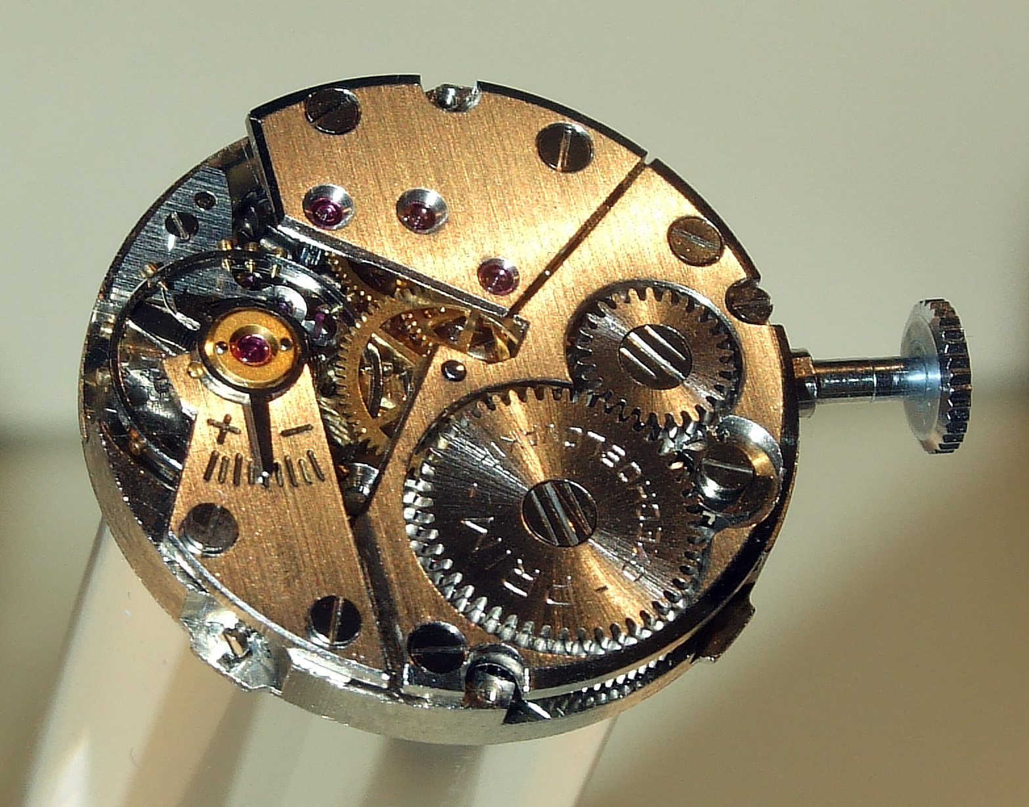
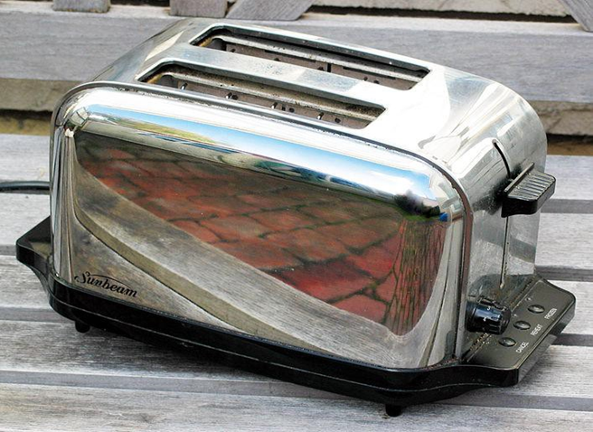
Forms of Energy
Explain
All Images in Powerpoint obtained from: commons.wikimedia.org

Slide 2
Directions
For the Explain portion of the section, work through each slide
For each form there are three slides:
Introduce the form of energy
Give examples of the form of energy
Lead a student discussion about other examples of that form of energy.

Slide 3
Mechanical Energy
Definition: Mechanical energy is the energy that an object has because of it's motion or position. Mechanical energy can be kinetic (in motion) or potential (stored energy).

Slide 4
Mechanical Energy
2. Teacher Explanation: A roller coaster is an example of mechanical energy because of the amount of energy that is stored before you move and then the amount of energy being used as you travel around the track!

Slide 5
Mechanical Energy
3. Student Discussion: Why are these pictures examples of mechanical energy? Can these pictures be examples of any other forms of energy?

Slide 6
Chemical Energy
3. Student Discussion: Why are these pictures examples of chemical energy? Can these pictures be examples of any other forms of energy?
1. Definition: Chemical energy is energy that is stored in chemical compounds (atoms and molecules). The energy is released when the bonds are broken.

Slide 7
Chemical Energy
3. Student Discussion: Why are these pictures examples of chemical energy? Can these pictures be examples of any other forms of energy?
2. Teacher Explanation: This girl is eating a peach, her body will eventually break down the peach through digestion by several chemical reactions and use the nutrients for energy she will need to grow and play.

Slide 8
Chemical Energy
3. Student Discussion: Why are these pictures examples of chemical energy? Can these pictures be examples of any other forms of energy?

Slide 9
Electrical Energy
1. Definition: Electrical energy is energy that is caused by the movement of charged particles in an electrical field.

Slide 10
Electrical Energy
2. Teacher Explanation: In this picture electrical energy or electricity is made available to homes and businesses by charged particles moving through the power lines. Power lines are an example of a conductor.

Slide 11
Electrical Energy
3. Student Discussion: Why are these pictures examples of electrical energy? Can these pictures be examples of any other forms of energy?

Slide 12
Sound Energy
3. Student Discussion: Why are these pictures examples of sound energy? Can these pictures be examples of any other forms of energy?
1. Definition: Sound energy is the movement of energy through compressional waves that travel in a medium such as water, air, or solids.

Slide 13
Sound Energy
3. Student Discussion: Why are these pictures examples of sound energy? Can these pictures be examples of any other forms of energy?
2. Teacher Explanation: Dolphins communicate through echolocation taking advantage of sound waves under water. The sound waves move through the water, and bounce off the object to return to the dolphin. When they receive the information their auditory nerves create an acoustic picture of the object (www.pbs.org)

Slide 14
Sound Energy
3. Student Discussion: Why are these pictures examples of sound energy? Can these pictures be examples of any other forms of energy?
3. Student Discussion: Why are these pictures examples of sound energy? Can these pictures be examples of any other forms of energy?

Slide 15
Heat Energy
3. Student Discussion: Why are these pictures examples of heat energy? Can these pictures be examples of any other forms of energy?
1. Definition: Heat energy is the energy caused by moving particles. Heat energy always flows from warmer to cooler. Things don’t get cool. Things just lose heat.

Slide 16
Heat Energy
3. Student Discussion: Why are these pictures examples of heat energy? Can these pictures be examples of any other forms of energy?
2. Teacher Explanation: While a toaster uses electrical energy to power it, it transfers to heat energy. The heat energy warms the coils and this energy spreads from the hot coils to the cold bread you placed in the toaster.

Slide 17
Heat Energy
3. Student Discussion: Why are these pictures examples of heat energy? Can these pictures be examples of any other forms of energy?
3. Student Discussion: Why are these pictures examples of heat energy? Can these pictures be examples of any other forms of energy?

Slide 18
Light Energy
3. Student Discussion: Why are these pictures examples of light energy? Can these pictures be examples of any other forms of energy?
1. Definition: Light energy is radiant energy that contains light you can see. Light energy can travel through space, where sound can’t. The different kinds of light waves are part of the electromagnetic spectrum. Light can be absorbed, reflected or refracted.

Slide 19
Light Energy
3. Student Discussion: Why are these pictures examples of light energy? Can these pictures be examples of any other forms of energy?
2. Teacher Explanation: The sun and stars are examples of light energy. They provide a natural source of light and this light energy travels all the way to the earth. The sun’s light energy is so powerful it can even be converted to electrical energy through solar power!

Slide 20
Light Energy
3. Student Discussion: Why are these pictures examples of light energy? Can these pictures be examples of any other forms of energy?
3. Student Discussion: Why are these pictures examples of light energy? Can these pictures be examples of any other forms of energy?

