Slide 1
Homeostasis and Cell Processes

Slide 2
Homeostasis
For your body to stay healthy cells must :
Obtain and use energy
Make new cells
Exchange material
Eliminate waste
Homeostasis ensures that cells can carry out these tasks

Slide 3
All Cells need Energy and materials to survive
In unicellular organisms – the cell membrane regulates what goes in and out of the cell. – maintaining homeostasis
In Multicellular organisms – cells work together to maintain homeostasis for the entire organism.

Slide 4
Transport System
Plants have two vascular systems to maintain homeostasis
Xylem – tissue that transports water and minerals from roots to rest of plant
Phloem – tissue that transports food throughout the plant

Slide 5
How cells get energy
Photosynthesis and Cellular respiration
Photosynthesis -
Plants use sun to change carbon dioxide and water into sugar and oxygen
Takes place in chloroplast
Cellular Respiration –process by which cells use oxygen to produce energy from food
Plant, animals and most organisms use cellular respiration to get energy from food

Slide 6
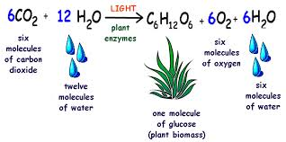
Photosynthesis chemical equation
Water + Carbon Dioxide => sugar + Oxygen
https://www.brainpop.com/science/cellularlifeandgenetics/photosynthesis/

Slide 7
Cellular Respiration equation
https://www.brainpop.com/science/cellularlifeandgenetics/cellularrespiration/

Slide 8
How do cells Divide?
Cells grow, divide and die
Cell division in Eukaryotic cells is called mitosis – resulting in two identical cells
They have the same genetic material
https://www.brainpop.com/science/cellularlifeandgenetics/mitosis/

Slide 9
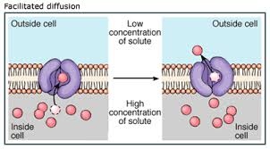
How do cells exchange materials?
1. Passive Transport – movement of particles across cell membrane without the use of energy
Diffusion – the movement of molecules from high concentration to low concentration
Osmosis – diffusion of water

Slide 10
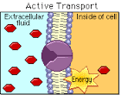
Active Transport
2. Active Transport - Movement of particles against a concentration gradient and requires energy.

Slide 11
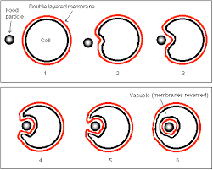
Endocytosis
3. Endocytosis
Cell uses energy to surround a particle – cell membrane wraps around particle to bring it into cell

Slide 12
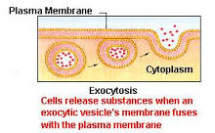
Exocytosis
4. Exocytosis - Particles that are enclosed in vesicle and released from cell

Slide 13
How do organisms maintain homeostasis
Cells must work together to maintain homeostasis
Ex. When an organism is cold cell respond to maintain body temp.
Warm-blooded animals muscle cells contract to generate heat.

